Slide 1
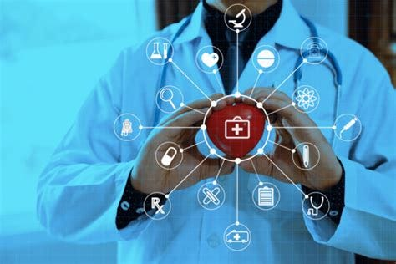
HUMAN DISEASE PREDICTION
BATCH NUMBER:12
T. SRAVAN - 22N31A66H3
Y. SASIDHAR REDDY - 22N31A66J7
RAGHAVENDRA -22N31A66E9
UNDER THE GUIDANCE OF
MR MD. AZHAR
ASSISTANT PROFESSOR
1

Slide 2

AGENDA :
ABSTRACT
EXISTING SYSTEM
PROPOSED SYSTEM
FUTURE ENHANCEMENTS
MODULAR DESCRIPTION
ARCHITECTURE DIAGRAM
UML DIAGRAMS
ER DIAGRAM
REQURIMENT SPECIFICATIONS
REFERENCE
CONCLUSION
2

Slide 3
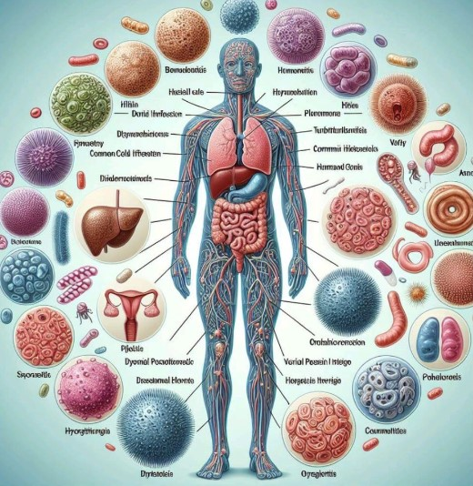
ABSTRACT :
This system is mainly based on Human Disease Prediction by using SVM(Support Vector Machine) algorithm.
We make use of machine learning algorithm(SVM) to predict the diseases based on user-input symptoms.
By entering user input symptoms into the system, users can receive more precise predictions about their potential health conditions, improving early diagnosis and treatment.
Traditional diagnostic methods often involve a combination of medical assessments and tests, which can be both time-consuming and expensive.
Hence, This project aims to reduce the time-consuming and expenditures of the user.
3

Slide 4
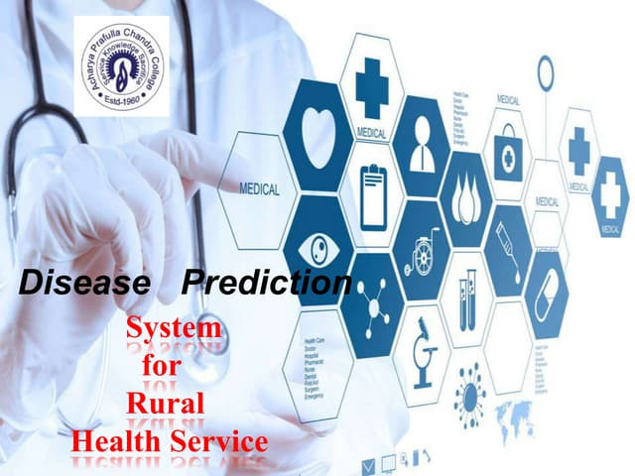
EXISTING SYSTEM :
Health Apps with Symptom Checkers: Mobile apps offer symptom assessments and health advice based on simple predictive models.
Genetic Risk Assessment Tools: Tools analyze genetic data to assess disease risk but may not use machine learning algorithms like SVM for prediction.
Electronic Health Records (EHR) Systems: EHRs store patient data and medical history but often lack advanced predictive analytics.
4

Slide 5
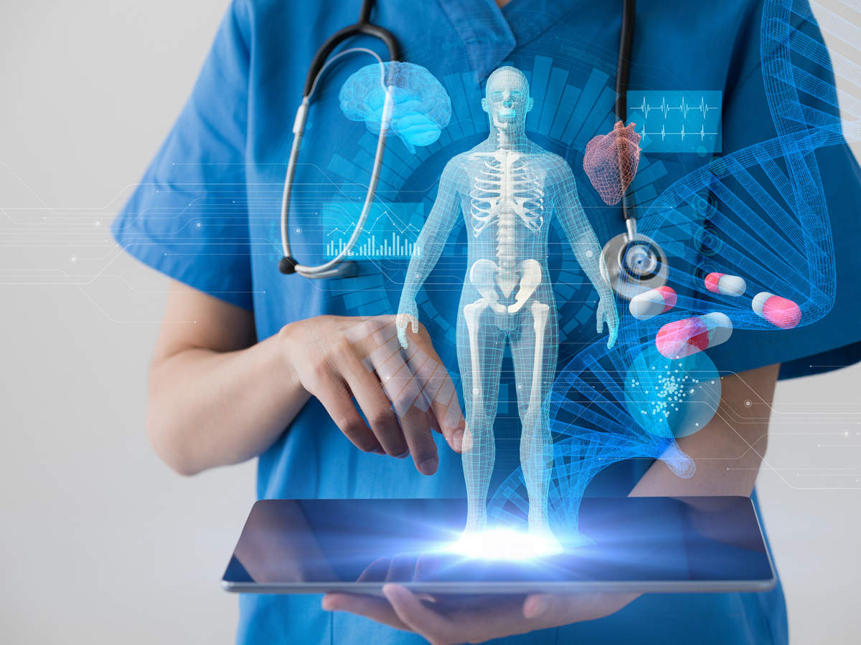
PROPOSED SYSTEM :
This project uses the Support Vector Machine algorithm to predict human diseases based on input symptoms.
This system collects user symptoms, processes the data, and uses the trained SVM model to provide accurate disease predictions.
The system will maintain a continually updated system -disease database.
The system will be built to be user-friendly, with a strong emphasis on privacy and security.
5

Slide 6
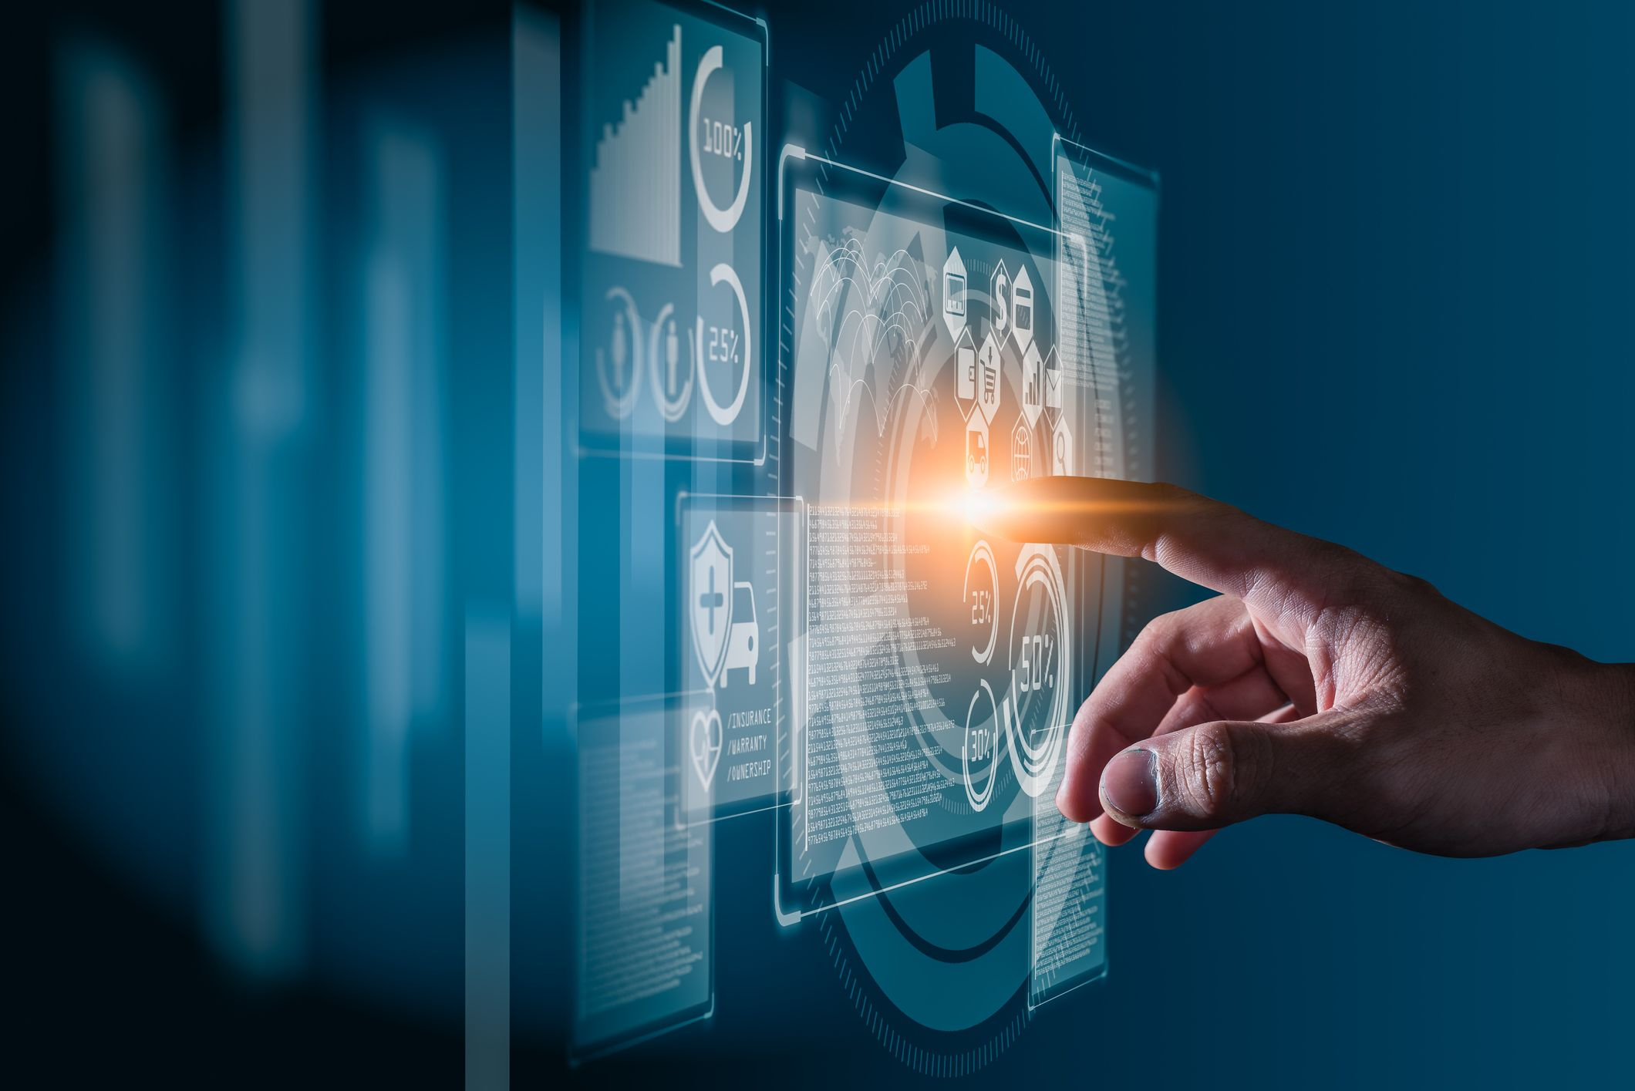
FUTURE ENHANCEMENTS :
Integration of Multi-Models.
Use of Advanced Machine Learning Models.
Adding more number of Symptoms.
6

Slide 7
MODULE DESCRIPTION:
We have five modules in our project namely:
User Module: In the User module, the user gives the input as symptoms to the system and
the system preprocess the given symptoms and produces an output as a disease.
Pre-Processing Module: In this module, the symptoms are preprocessed to extract
the useful features.
Training Module: Once the model is created, it has to be trained. We have a
predefined dataset that contains the symptoms and diseases. Using this dataset the model
is trained.
Testing Module: Once the model is created, it has to be tested. We have a
predefined dataset that contains the symptoms and diseases. Using this dataset the model
is tested.
Prediction Module: In this module, the model predicts the disease of a user.

Slide 8
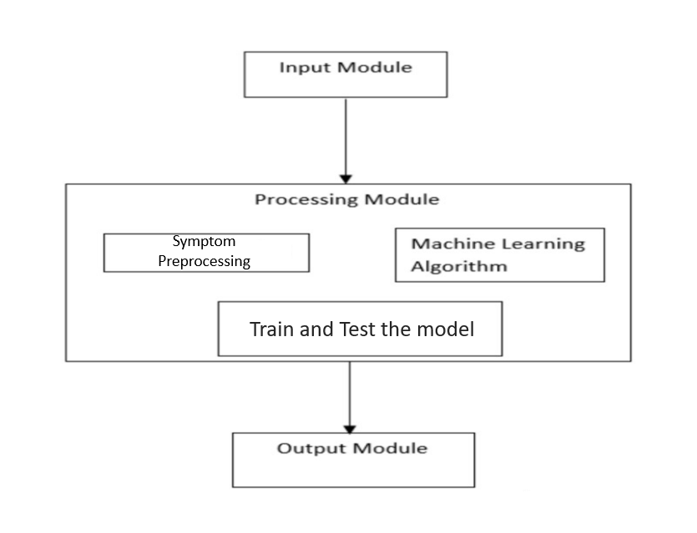
ARCHITECTURE DIAGRAM:

Slide 9
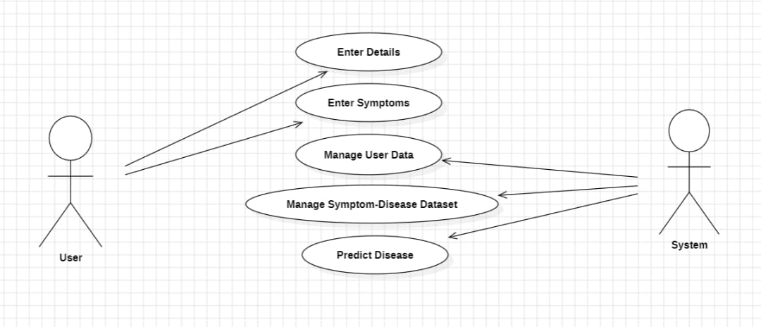
UML(unified modelling language) DIAGRAMS:
USECASE DIAGRAM:

Slide 10
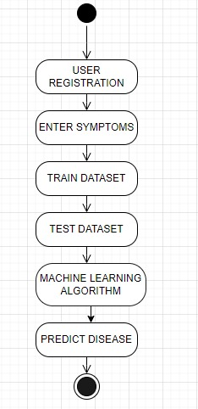
ACTIVITY DIAGRAM:

Slide 11
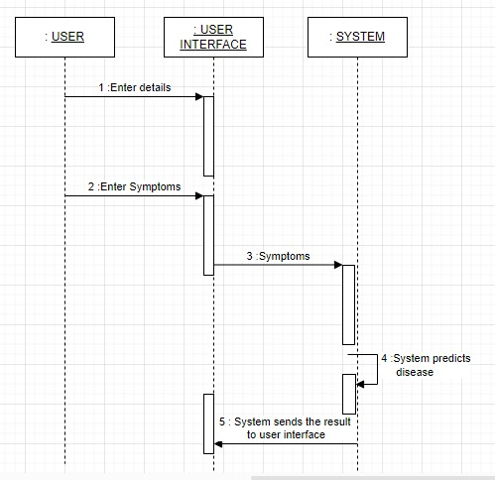
SEQUENCE DIAGRAM :

Slide 12
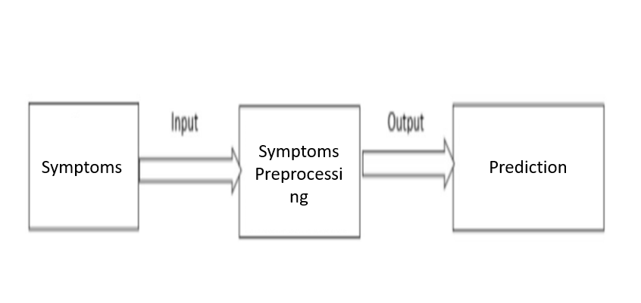
DATA FLOW DIAGRAM:

Slide 13
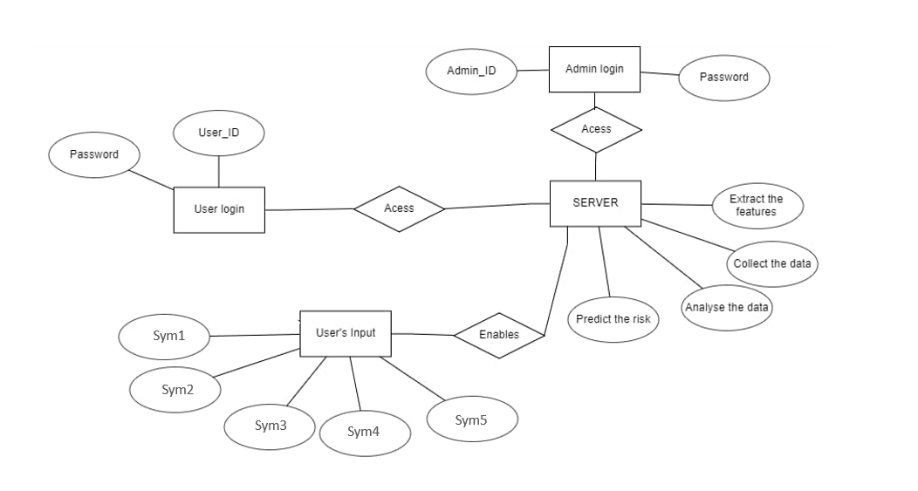
ER(ENTITY RELATIONSHIP) DIAGRAM:

Slide 14
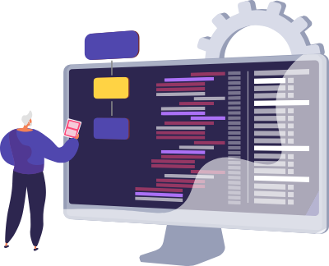
REQUIREMENT SPECIFICATIONS:
Software Requirements:
Operating System: Windows
Coding Language: Python 3.7
Platform : Jupyter Notebook
Modules : Numpy , Pandas
Hardware Requirements:
RAM: 8GB and above
Hard disk: 1 TB
Processor: intel i5

Slide 15
REFERENCE :
[1] [online] http://people.dbmi.columbia.edu/~friedma/Projects/DiseaseSymptomKB/index.html
[2] [online] Disease Prediction and Doctor Recommendation System by https://www.irjet.net
[3] [online] GDPS - General Disease Prediction System by https://www.irjet.net
[4] Jaymin Patel, Prof.Tejal Upadhyay, Dr. Samir Patel “Heart disease prediction using Machine learning and Data Mining Technique" Volume 7.Number1 Sept 2015March 2016.
[5] [online] https://ieeexplore.ieee.org/document/8819782
[6] “Disease Prediction Using Machine Learning Over Big Data” Vinitha S, Sweetlin S, Vinusha H and Sajini S (2018).
[7]“Multi Disease Prediction Using Data Mining Techniques”K.Gomathi , Dr. D. Shanmuga Priyaa (2017).
7

Slide 16
CONCLUSION :
This project demonstrates that machine learning for disease prediction is highly beneficial in everyday life, especially for the healthcare sector.
By inputting general information and symptoms, this system quickly provides accurate disease diagnoses and offering a convenient alternative for users who prefer not to visit medical facilities.
If adopted widely, this technology could reduce doctors' workloads by enabling efficient disease identification, potentially preventing treatable conditions from becoming severe and affecting patients and their families.
8

Slide 17

.
9

